Slide 1
ISMAR 2021: Discover Bari and the Apulia Region
Put your
logos here
Joe Gabbard, Michele Fiorentino, Antonio Emmanuele Uva, Veronica Teichrieb

Slide 2
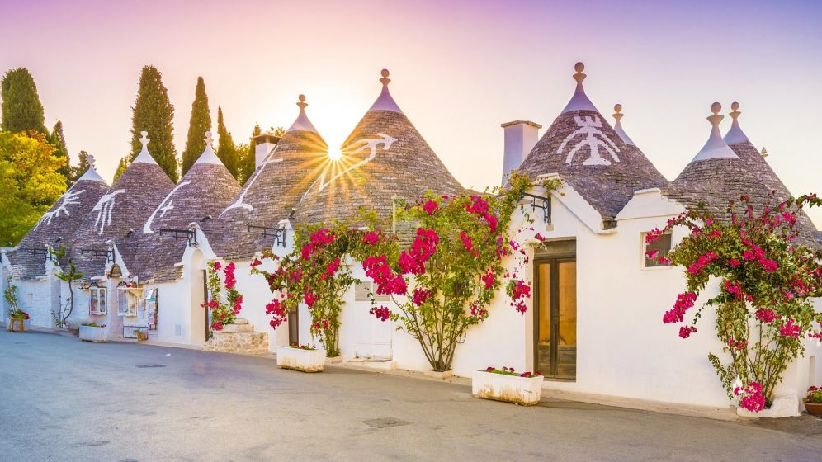
Why Apulia?
Apulia's economic structure is based on industry, tourism, commerce, services, and administration.
Several public and private universities.
Production of olive oil, wine, dairy products
Redirecting you to https://www.viaggiareinpuglia.it/hp/en
Sunset on the characteristic trulli of Alberobello, Bari, UNESCO heritage

Slide 3
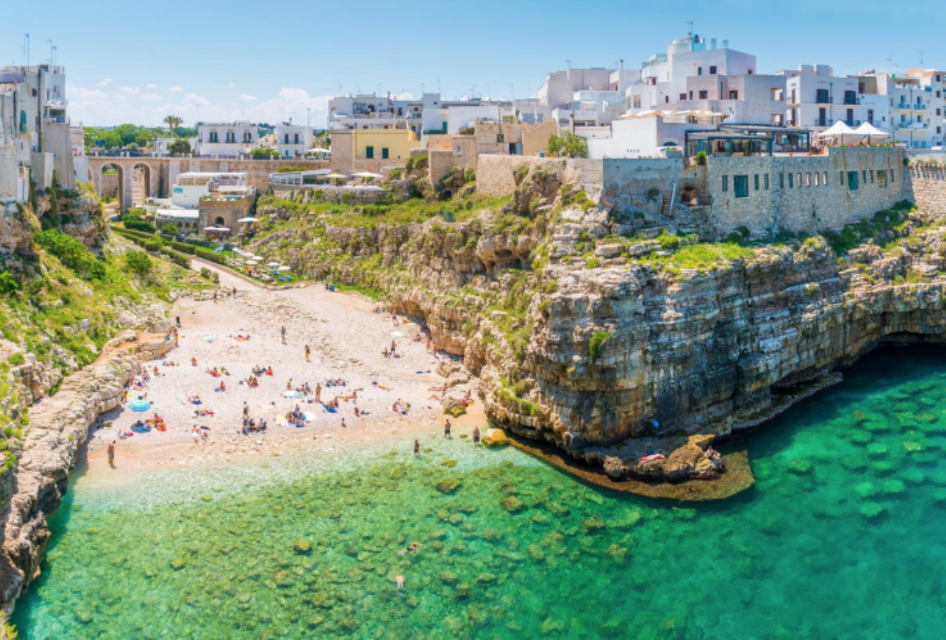
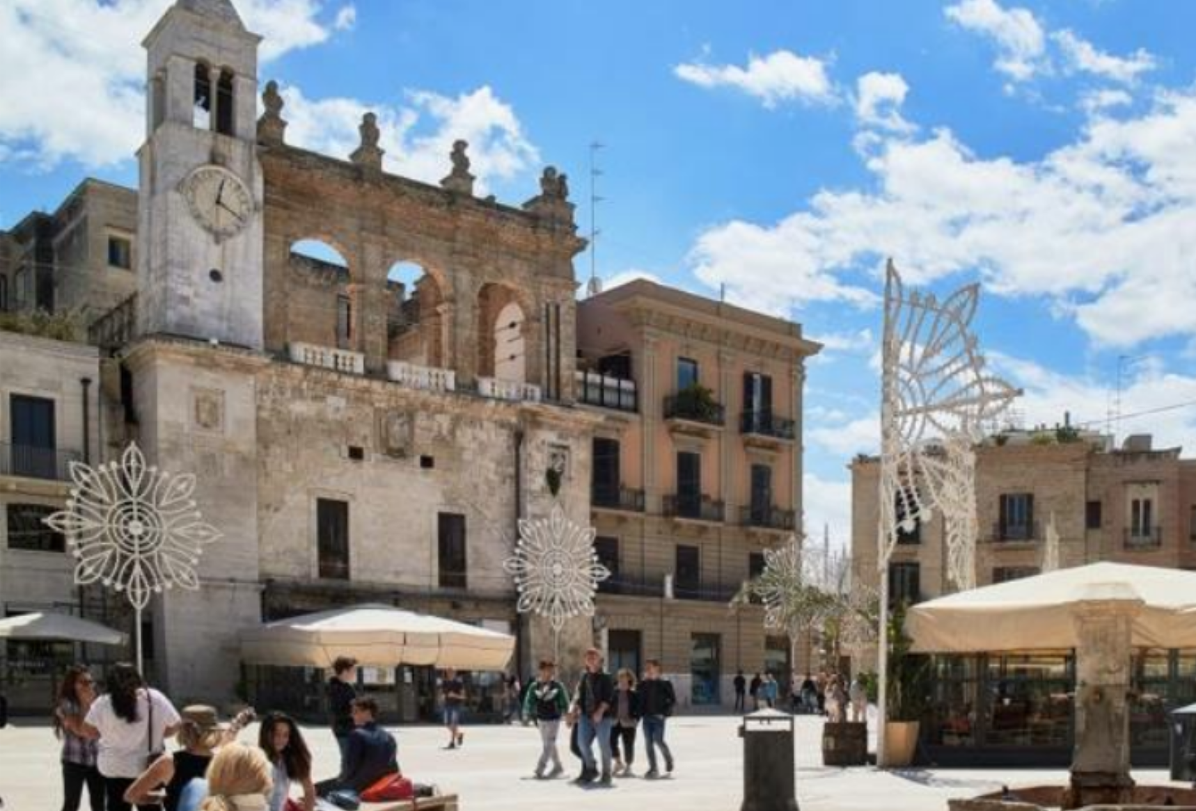
Here can I travel to enjoy more of Apulia?
Aerial view on Lama Monachile bay in Polignao a Mare, Bari
Piazza Mercantile, the ancient market square in the Old Town of Bari

Slide 4
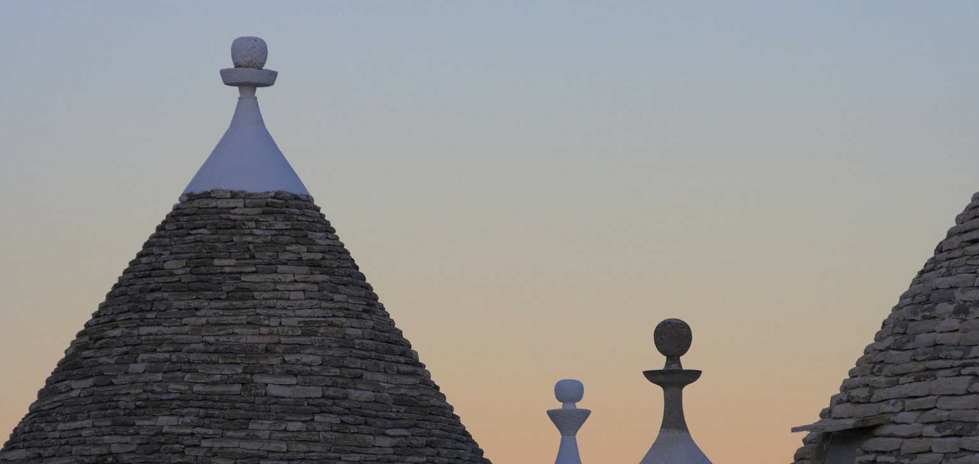
The Logo
spiritual or propitiatory motifs. Usually made up of three overlapping stones, its true meaning is still obscure, despite the various hypotheses advanced over time.
Whether it hides magical values, ornamental function or distinctive signs, the pinnacle was and is still a mystery that surprises the viewer’s eye, so that we want to convey it also in ISMAR 2021’s identity… Who seeks, finds!
This is the land where the wind blows among the olive trees and stops in front of the Trulli beauty. this construction leitmotif is its pinnacle: a decorative element with esoteric,

Slide 5
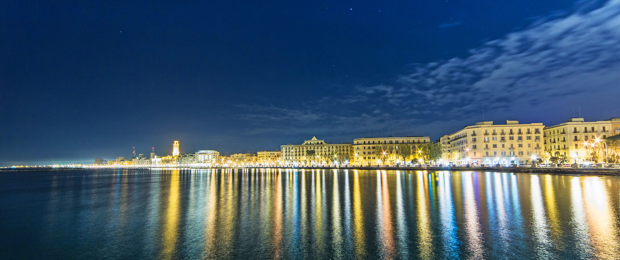
Night view of the Waterfront of Bari

